Slide 1


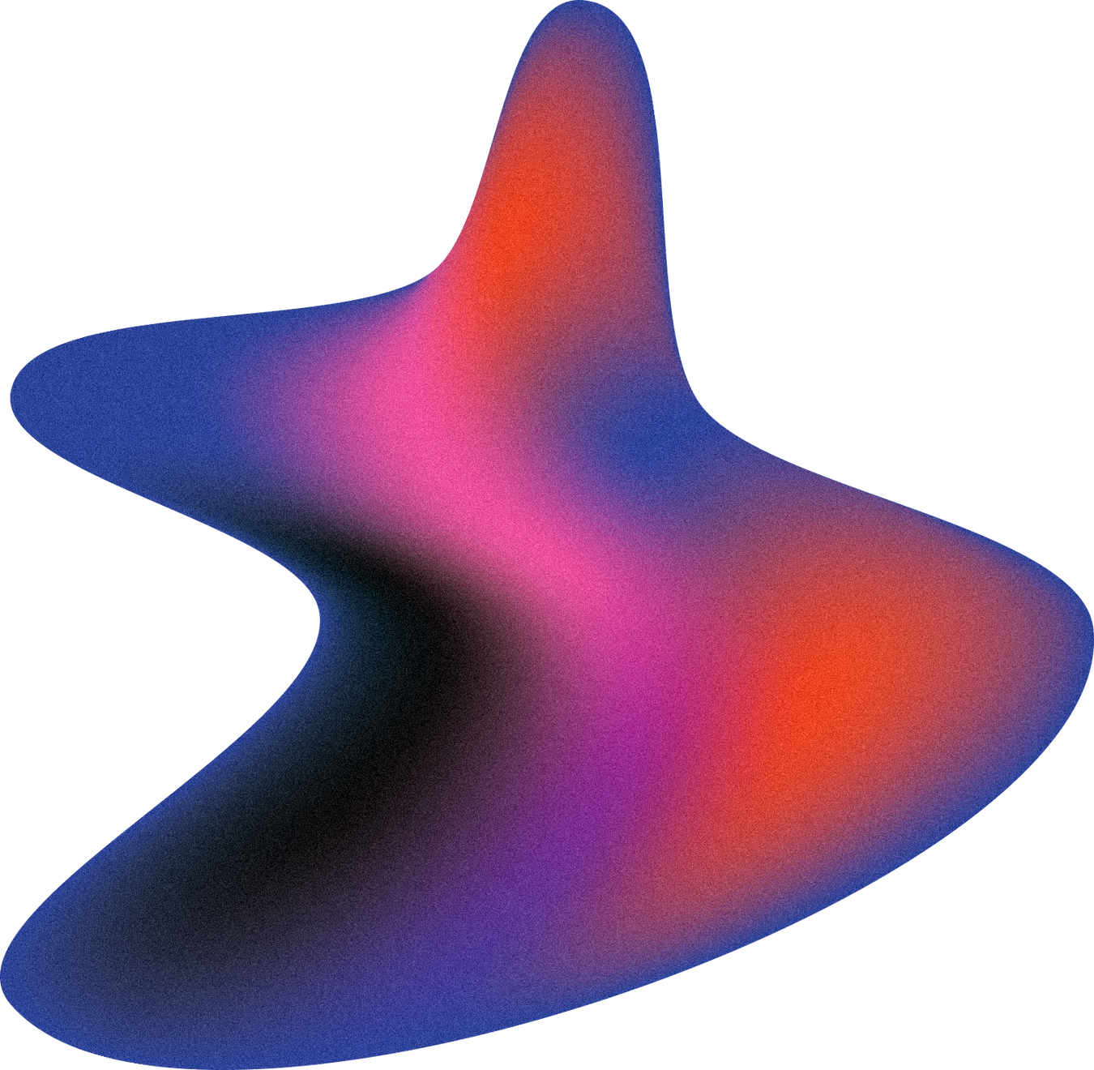
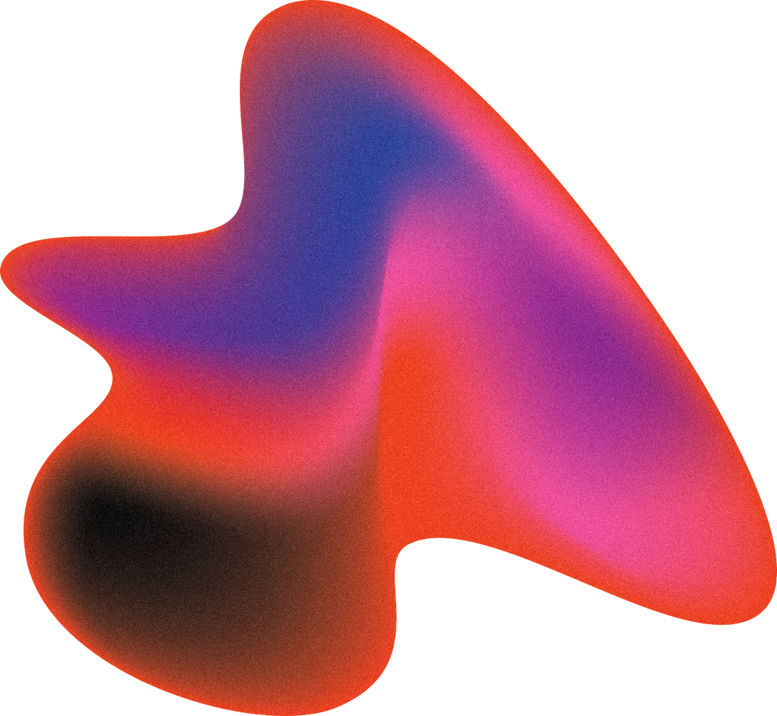
RADAR SYSYEM
USING ARDUINO

Slide 2
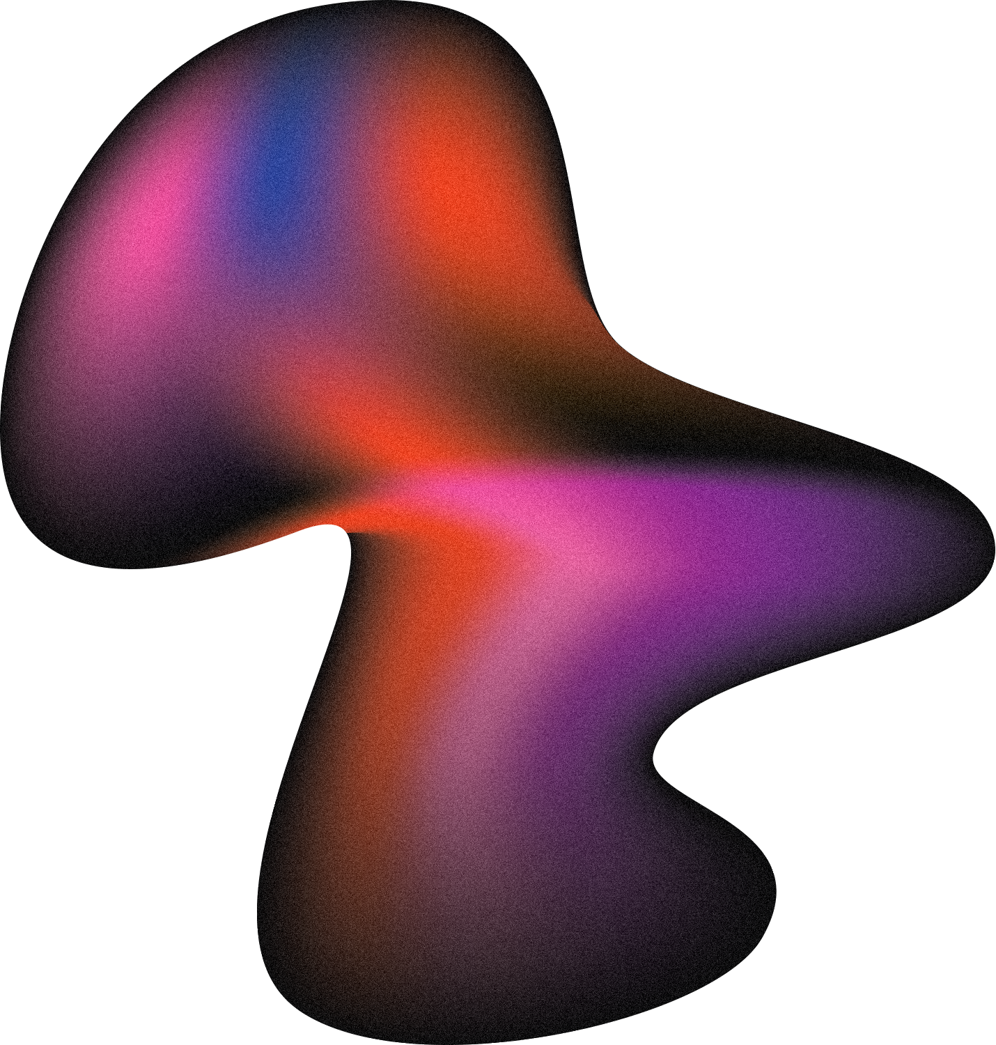
INTRODUCTION
This Project is specially about “ Making of RADAR SYSTEM USING ARDUINO at Home ”
What is Radar?
Uses of Radar
--RADAR stands for “Radio Detection And Ranging
--Object Detection System.
--Transmitter producing Electromagnetic Waves.
--Uses Ultrasonic Sound Waves to determine Distance, Angle, or Velocity of Objects.
--Used to detect Aircraft, Ships, guided missiles, motor vehicles, weather formation etc.

Slide 3

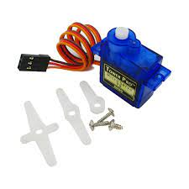
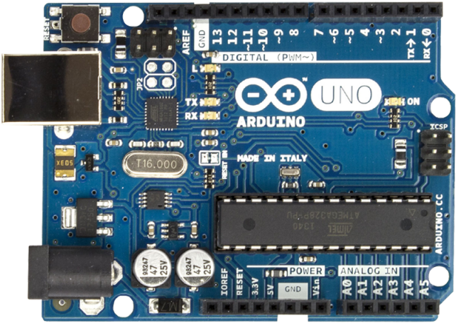
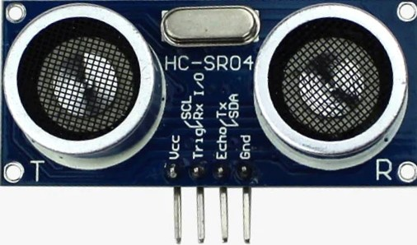
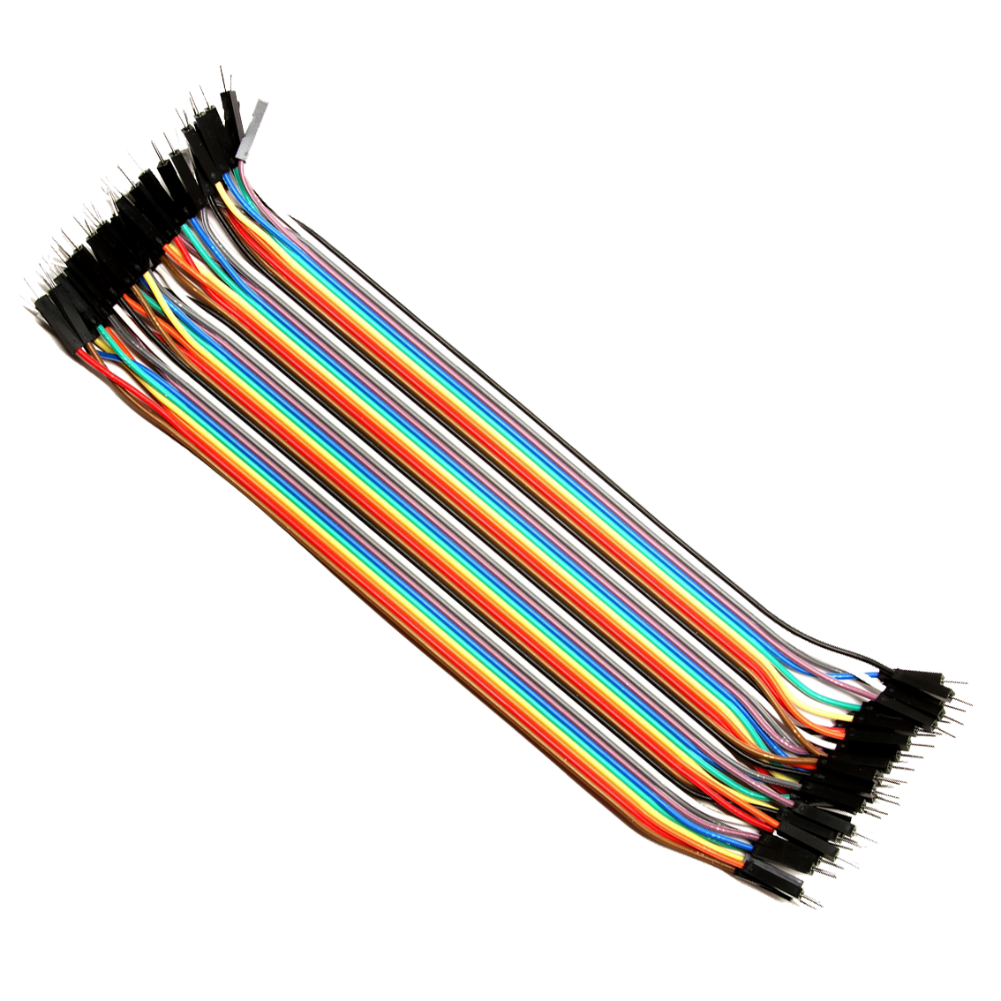
APPARATUS
01.
02.
03.
Arduino UNO
Ultrasonic Sensor HC-SR04
Servo Motor SG-90
.
04.
Jumper Wires

Slide 4
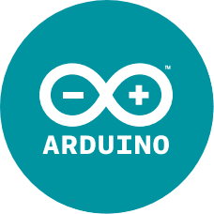

SOFTWARE
ARDUINO IDE
PROCESSING IDE

Slide 5
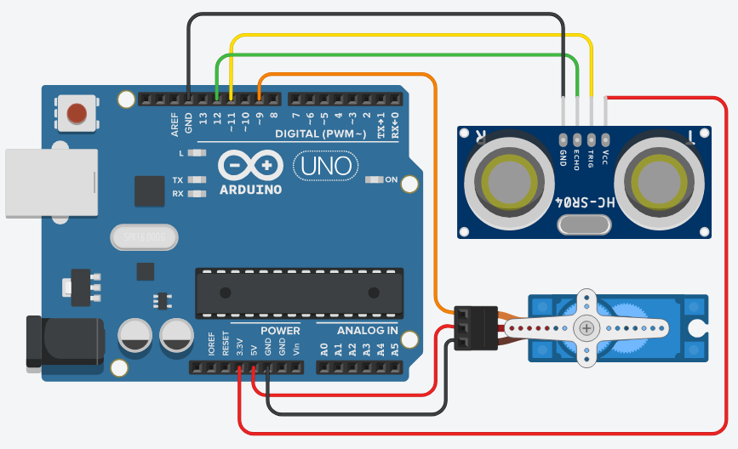
CIRCUIT DIAGRAM

Slide 6
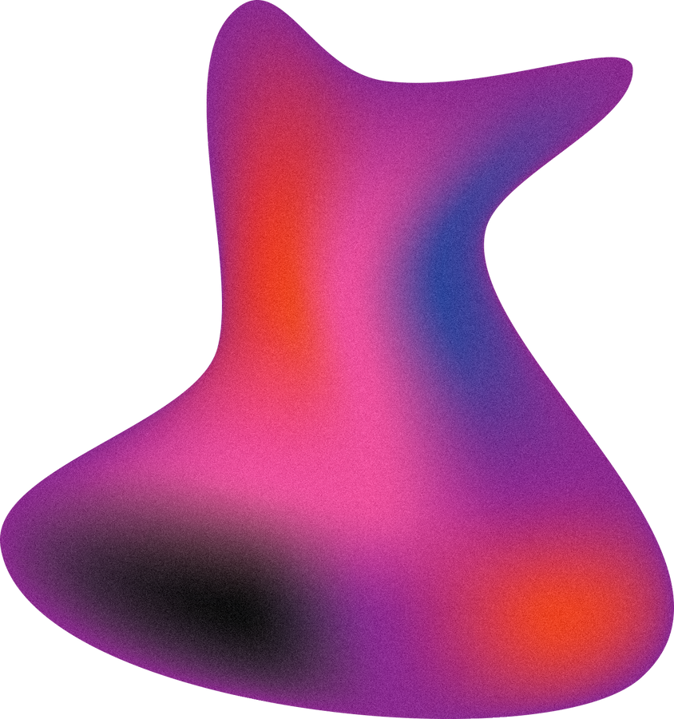
This Project Depends on Ultrasonic Sensor.
Through single strand wires the Ultrasonic Sensor is connected to the Arduino Board.
The Ultrasonic Sensor transmits Ultrasonic wave that reflects by an object, then our processing app process the data that come from the object.
WORKING

Slide 7
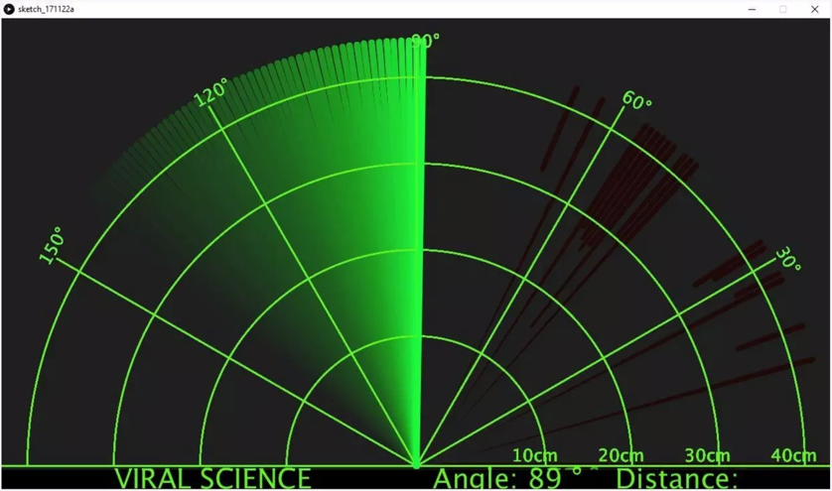
PERFORMANCE
No Object Detected

Slide 8
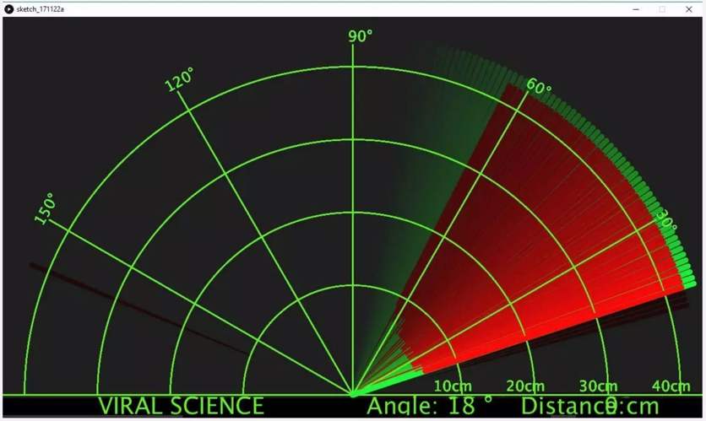
RESULT
Object Detected

Slide 9
Can see through the medium consisting of fog, snow. rain. darkness, clouds etc.
Can penetrate and see through Insulators.
Can distinguish fixed as well as moving target types.
Can help find out following parameters of object or target:
- Range
- Angular Position
- Location of Target
-Velocity of Target
ADVANTAGE

Slide 10
Can not distinguish and resolve multiple targets which are very close like our eye.
Can not recognize color of the targets.
Can not see targets which are placed behind some conducting sheets.
Also, difficult to recognize short range target types.
DISADVANTAGE

Slide 11
TEAM MEMBERS
Name1
Name2
Name3
Position
Position
Position

Slide 12
ACKNOWLEDGEMENT
We would like to thank all of the people who helped us with this project, without their support and guidance it wouldn't have been possible. We appreciate our Physics Teacher cum Project Guide Mr. Arnab Bera for his guidance and supervision which has provided a lot of resources needed in completing our project.

Slide 13
CONCLUSION
This System can be used in robotics for object detection, avoidance system and much more.
We’ve benefited a lot from the project and as a result of this project we’ve gained a lot of knowledge about RADAR System & Arduino.

Slide 14
THANK YOU!

